Slide 1
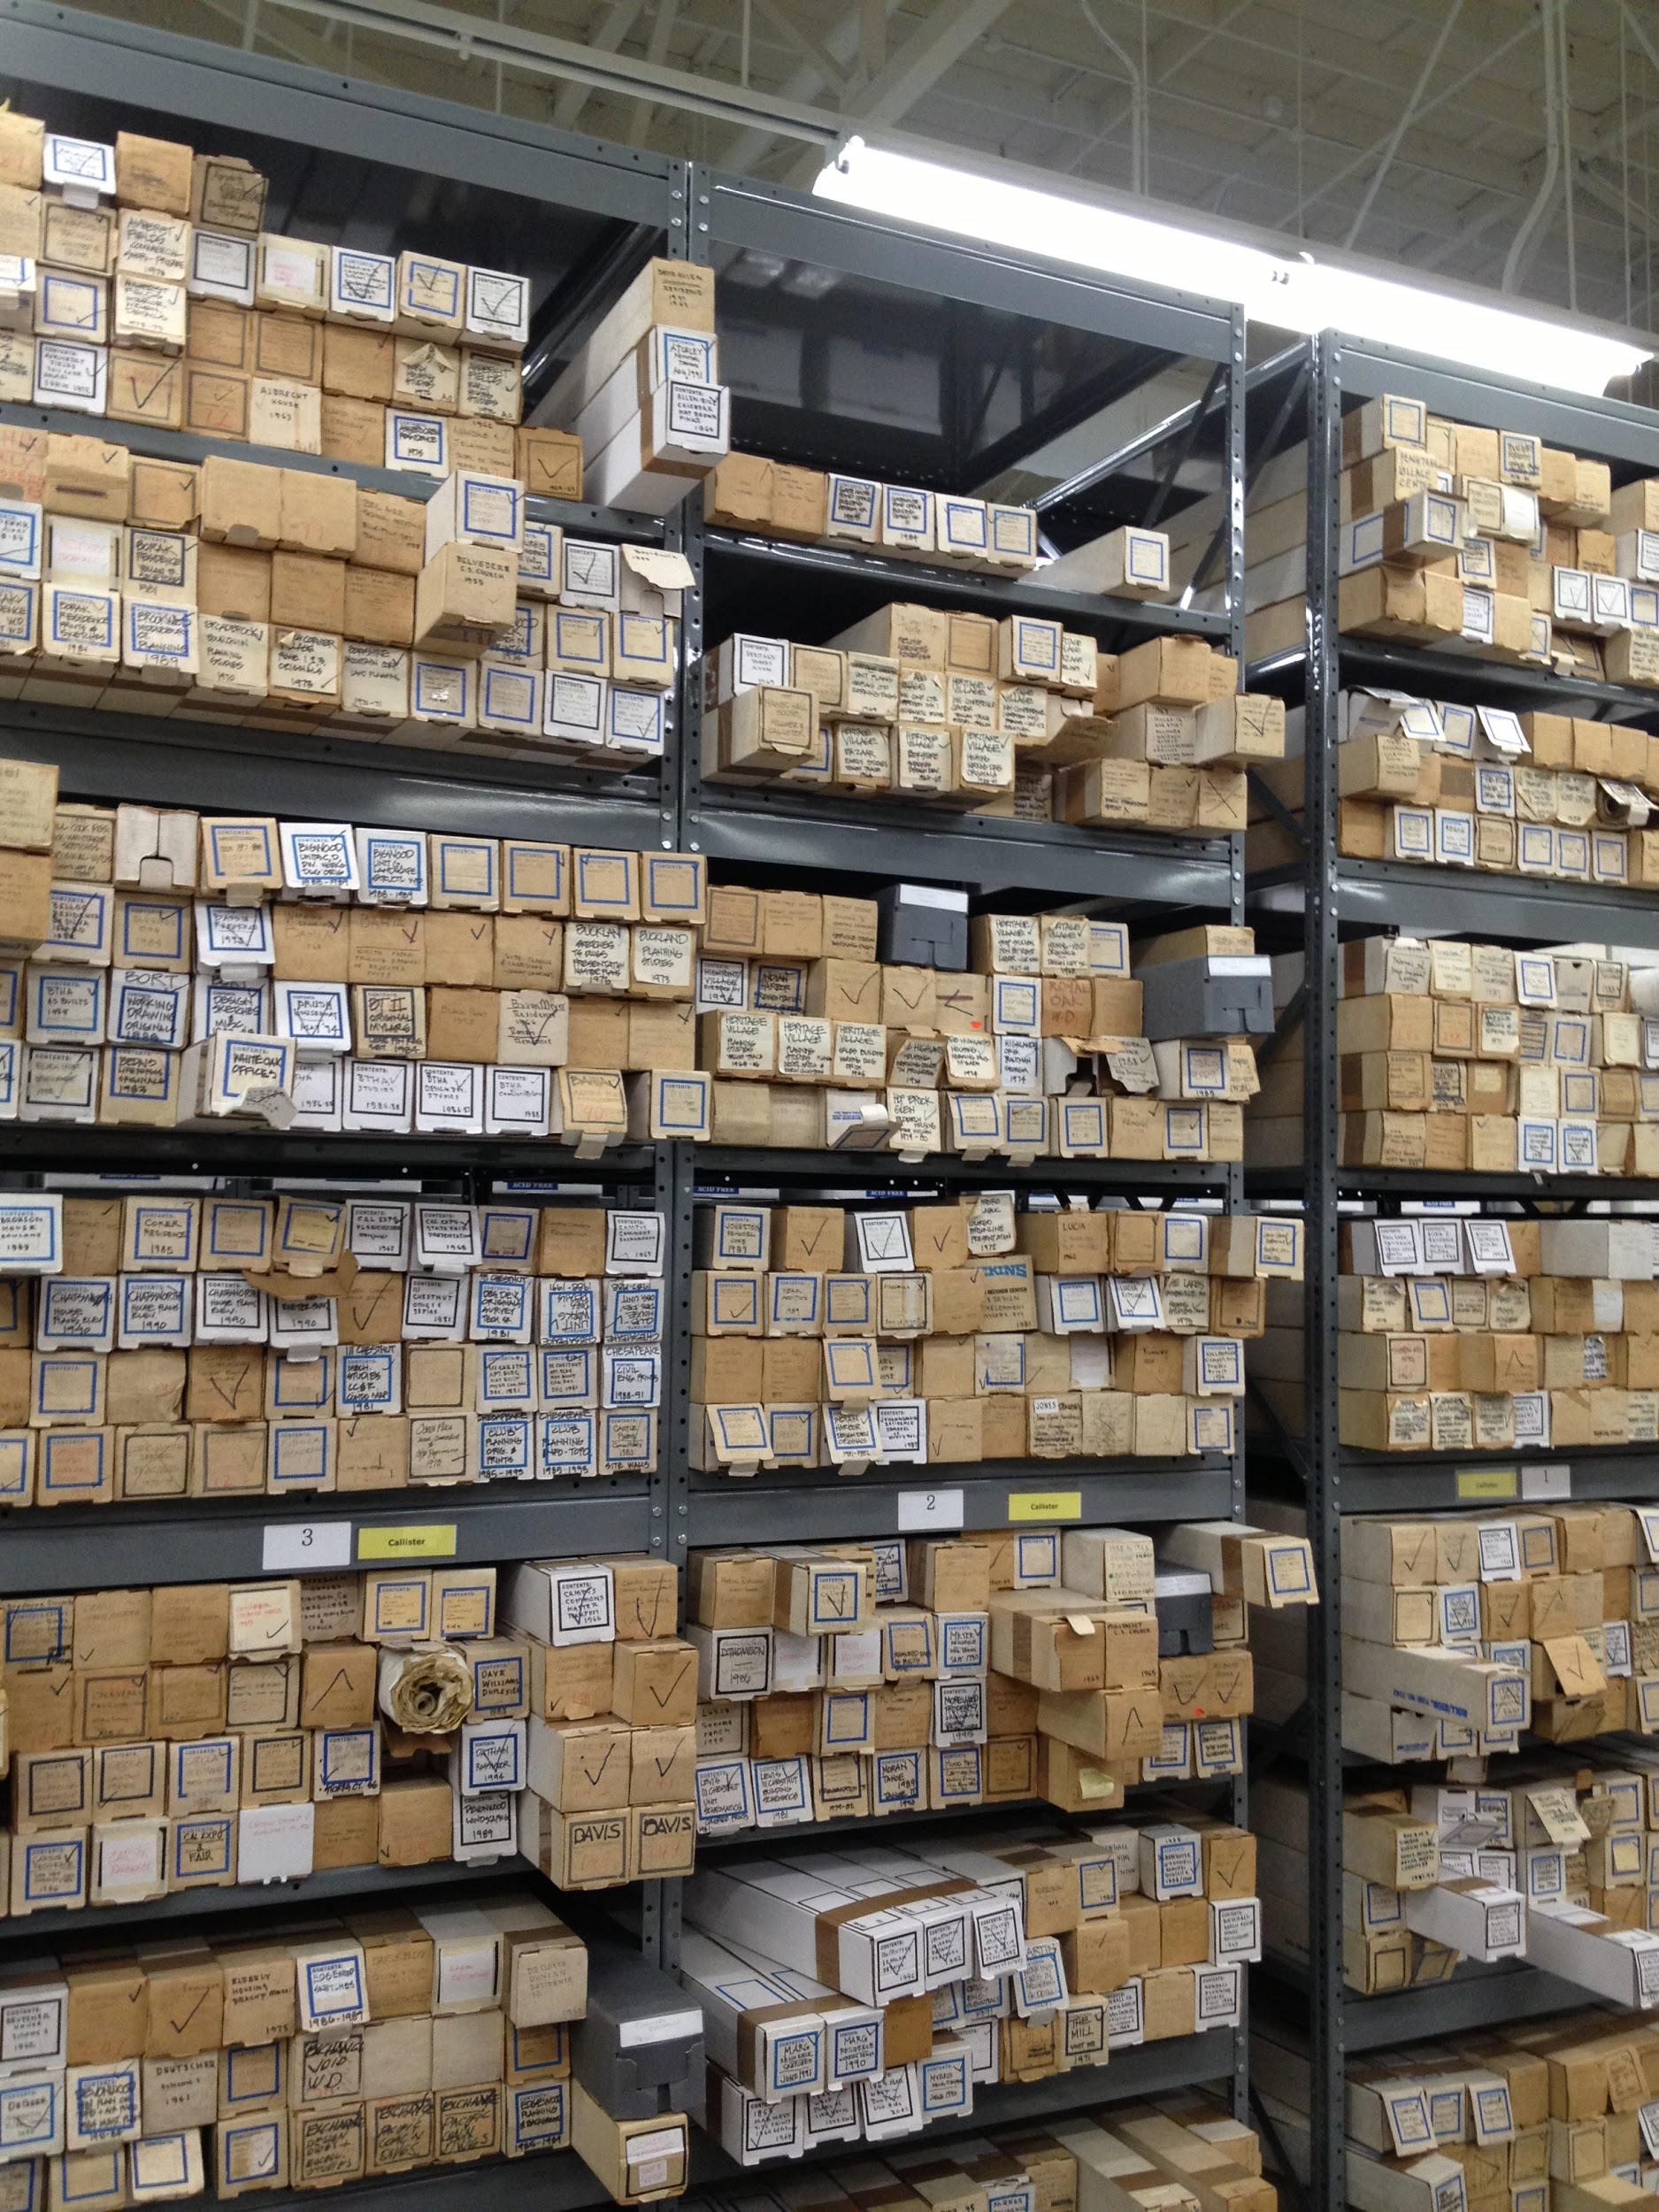
Proof of Existence
Methods for Adding Archival Resources to Wikipedia
Emily Vigor, Collections Archivist
Environmental Design Archives
UC Berkeley
SAA Research Forum
2017
Notes:
Hello, my name is Emily Vigor and I am the Collections Archivist at the Environmental Design Archives at UC Berkeley. Today I’ll be discussing
My research in how to apply primary resources from archival collections to Wikipedia articles as a way to expand and diversify the historical narrative, as well as a way to challenge Wikipedia’s assertion that articles can only be posted online if they cite valid, published, secondary resources

Slide 2
“If it’s not googleable, it doesn’t exist.” - Mia Ridge
Notes:
In Despina Stratigakos article, “Unforgetting Women Architects: From the Pritzker to Wikipedia,” she comments on the importance of the internet for preserving the cultural record. One of the main issues in preserving this history in today’s digital age is that you need an online presence to exist, meaning that if your history only exists in the repository and not online or in a Googleable published format, you are lost in the historical record. So how can we as archivists help make the histories in our repositories Googleable?
One answer is Wikipedia. Since Wikipedia articles usually show up at the top of Google search rankings, contributing to this website is a wonderful way to increase online visibility both for our own institutions and for new types of histories.

Slide 3
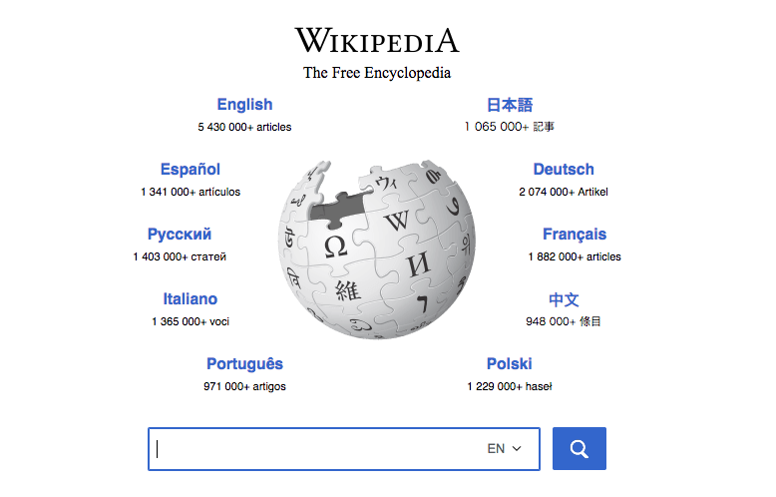
Notes:
While Wikipedia may seem like an unorthodox resource for diversifying the historical record, it is often the top listed link for a Google search. Wikipedia is the 7th most visited website in the world, and according to a 2013 study, over 98 percent of undergraduates report using Wikipedia at some point during their research process.

Slide 4
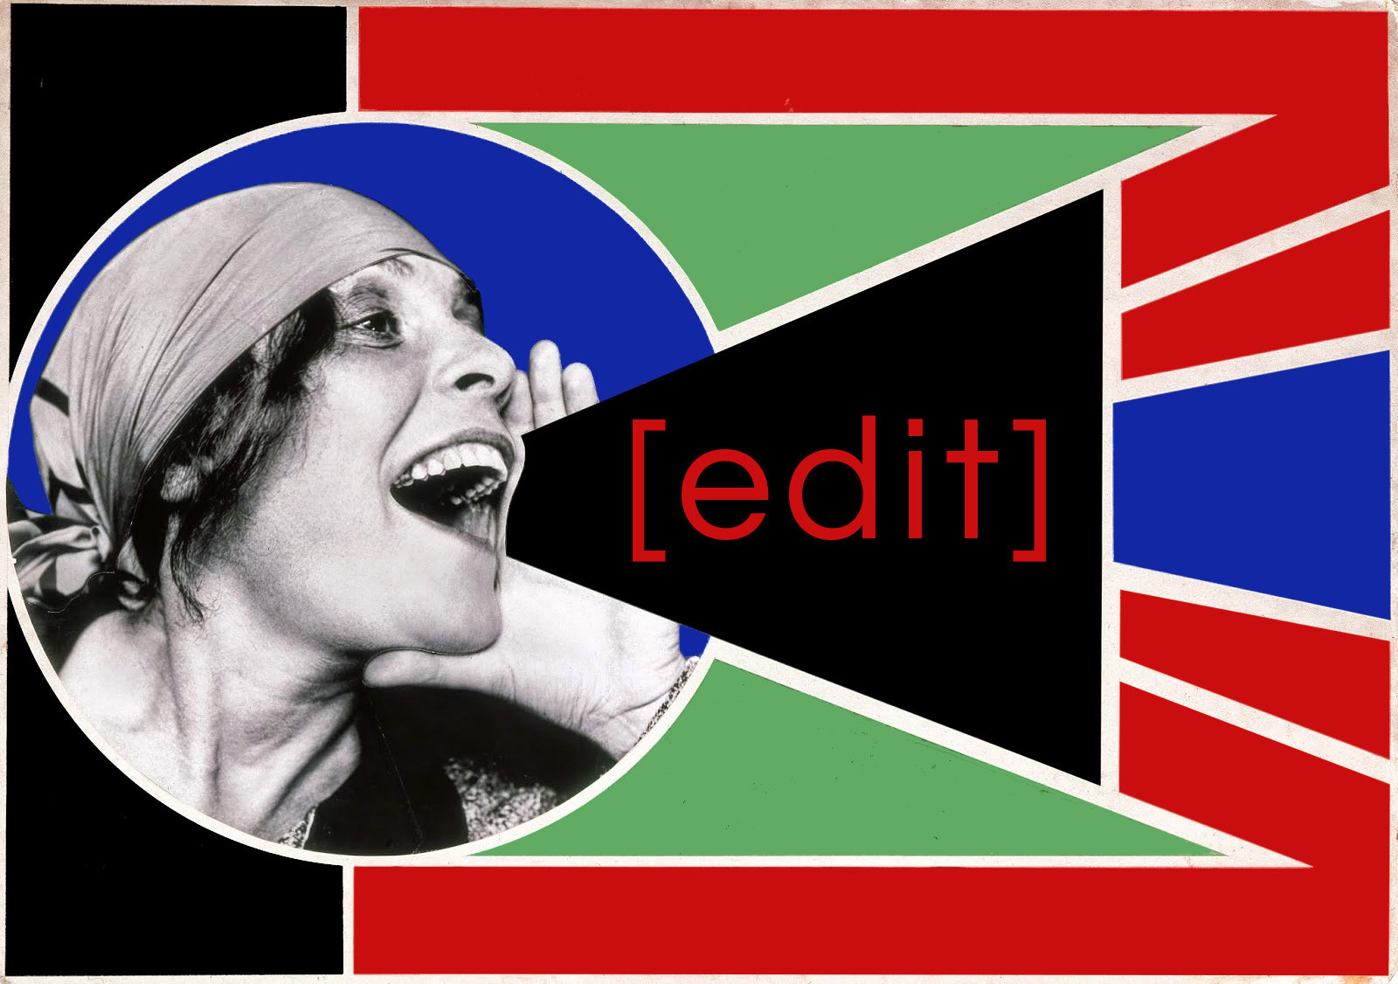
From www.moma.org
Notes:
The idea to use Wikipedia as a way to expand and diversify the historical narrative is not a new one. Wikipedia edit-a-thons have become increasingly more common, with programs through Art+Feminism, Architexx, and the Smithsonian’s “She Blinded Me With Science.” These edit-a-thons are important because they help to increase the histories available online, and they also focus on educating a diverse audience on how to create a Wikipedia article.

Slide 5
https://en.wikipedia.org/wiki/Wikipedia:No_original_research
Notes:
However, one of the main issues with Wikipedia continues to be that primary resources cannot be the main type of resource used to create a new page for a person, event or topic. This is problematic when there are no verifiable secondary resources available in published or online format to assist with the creation of a new page.

Slide 6
https://en.wikipedia.org/wiki/Wikipedia:Identifying_and_using_primary_sources
Notes:
Wikipedia articles require secondary resources to demonstrate notability, and currently primary resources cannot be used exclusively to create a new page. However, the number of primary or secondary resources needed for an article fluctuates between pages and is not clearly defined.
For framework, some reliable secondary sources include university-level textbooks, books published by respected publishing houses, magazines, journals, and mainstream newspapers. This can be a narrowly defined way of thinking about reputable resources.

Slide 7
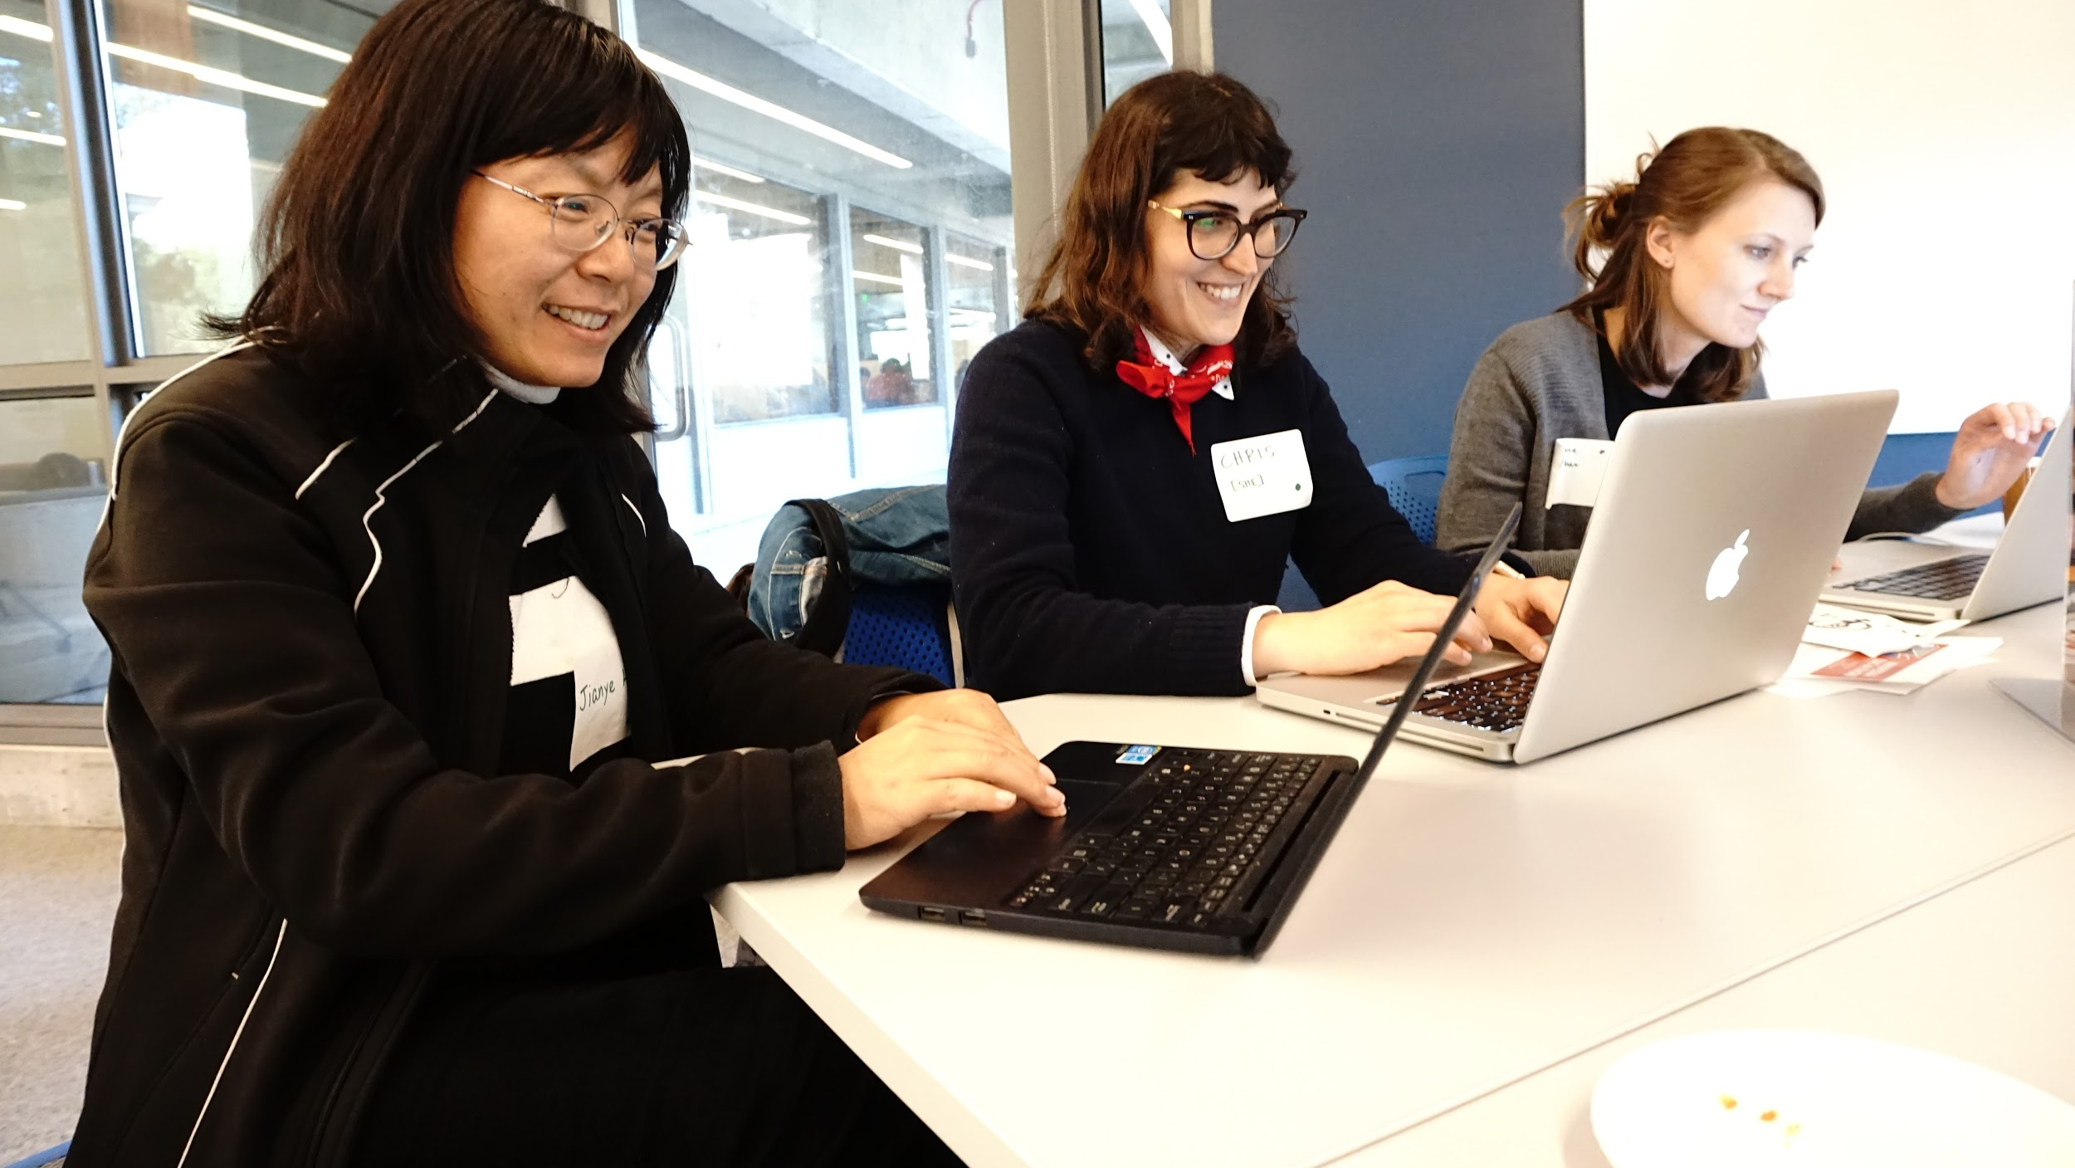
Notes:
After participating in several Wikipedia edit-a-thons at UC Berkeley, I became frustrated with the roadblocks put in place when I tried to publish certain pages for people who do not have enough published resources available to mark their notability. I was looking at at primary resources in collections we held proving their notability, but because no one had ever published a reputable secondary resource referencing them, they could not exist on Wikipedia.
Earlier this year after reading the article, “Out of the Vault: Developing a Wikipedia Edit-a-thon to Enhance Public Programming for University Archives Special Collections,” I found myself questioning whether it would be possible to publish a new page on Wikipedia where there are more primary resources than secondary ones.
In the article the authors discuss the University of Houston Libraries effort to develop a pilot program to add images and links to Wikipedia articles that connect to their digital collections website.
This program helps to diversify the types of histories made available on Wikipedia, but it also helps point viewers of a Wikipedia page to repositories that house these histories thereby serving as an additional access point to a broader public who may not be aware that these materials exist.

Slide 8
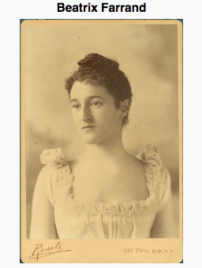
Notes:
In an effort to better understand the ability to publish primary resources on Wikipedia, I have started to test the ways in which they are accepted on pages that are already published.
Knowing that cited sources must be published, the definition of which for Wikipedia is made available to the public in some form, I wanted to see if I could use published finding aids and digitized images available online through Calisphere, a digital collections website for California repositories, and our Omeka instance to build on existing Wikipedia pages, and to potentially publish new pages comprised of these primary resources.

Slide 9
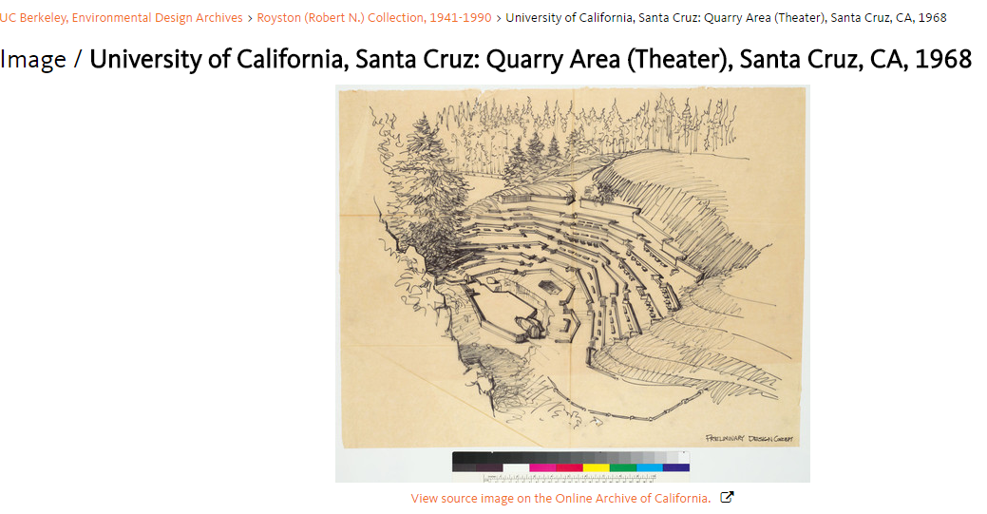
Added External Link
Notes:
I started by testing whether I could include images as external links and as citations to the reference list of pages that already exist for collections the EDA holds.
We’ve already used Wikipedia as a way to link users to our finding aids, but had not tried adding images.
My main question to test was whether the primary resource could count as proof. For me, this has meant testing whether a blueprint or drawing with an designer’s title block would be accepted as a reputable resource to support their notability in Wikipedia’s eyes.
Here you can see an example of how I added an image as an external link to a page that already exists

Slide 10
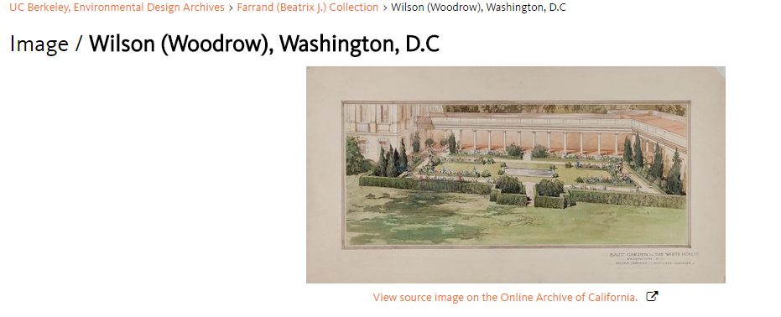
Added Citation
Notes:
I thought that adding these resources as external links would be accepted by Wikipedia editors reviewing my changes without question, but I was more concerned with whether images as stand alone references could also work.
Adding an image as a citation meant that the image link would be included in the resource list at the bottom of the article. What differs here is that I can cite the image and use it as a reputable resource to show notability, whereas the external link can be anything related to the person the page is about.

Slide 11
Results
Notes:
The good news is that including these images as citations and external links works! All of my edits were accepted.
We’ve only recently started tracking our Google Analytics for digital collections online, but we are seeing an increase in the number of people that click through to Calisphere from Wikipedia. This is wonderful news for us as it means we are reaching a broader audience, and it also means that our audience has the chance to view a broader range of resources we have not linked to Wikipedia.
The bad news is that I have not had success as of yet having a new page accepted that uses primary resources as the majority of citations listed. Images and finding aids alone are not enough at the moment, and in my case can also result in a conflict of interest in Wikipedia’s eyes as I am promoting an institution I work for and am not considered to be a neutral editor for the new page being created.

Slide 12
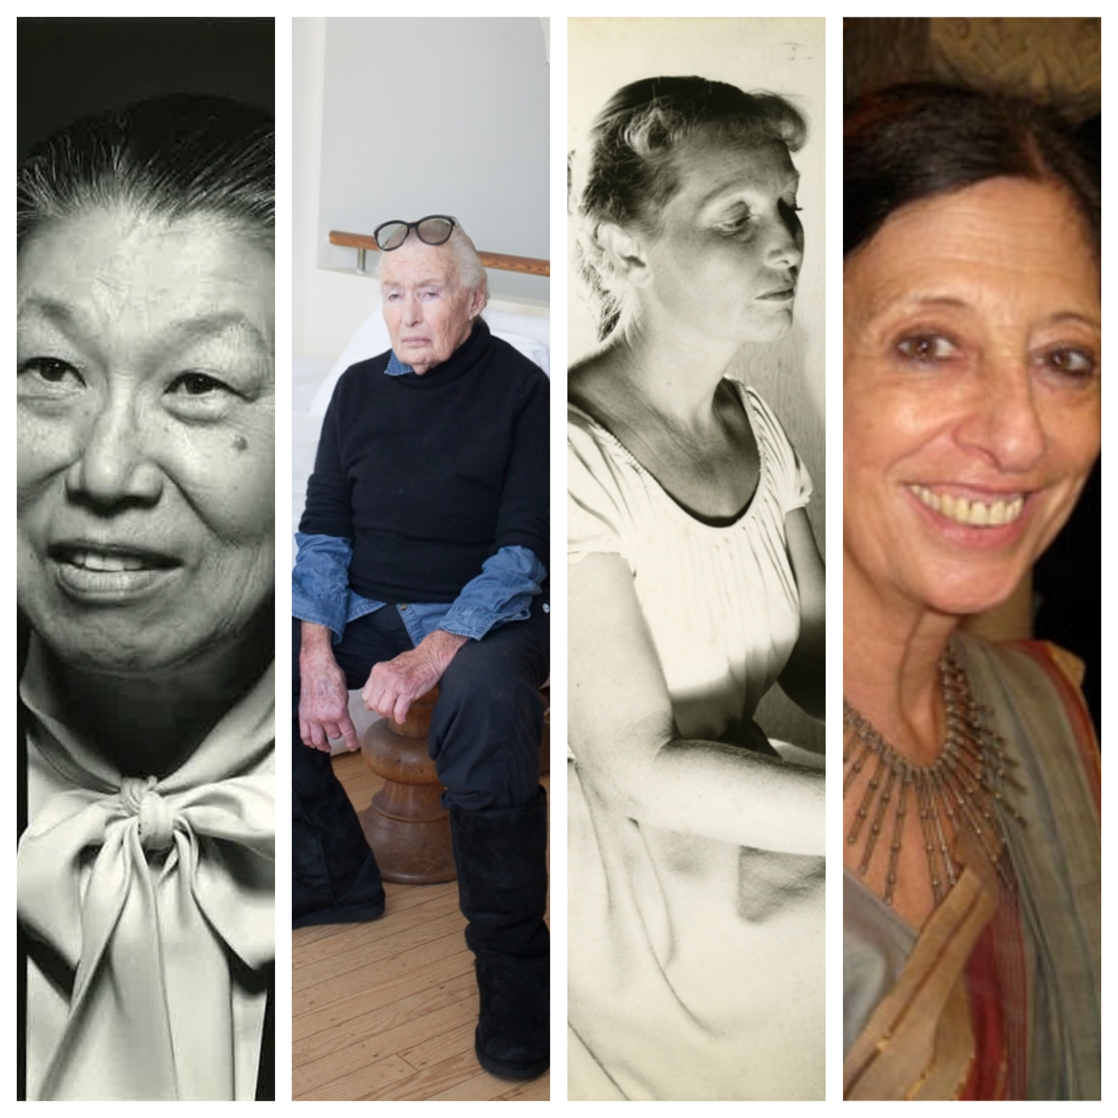
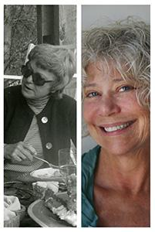
Next Steps
Notes:
My next effort will continue to focus on creating new Wikipedia pages, the majority of which will be comprised of primary resources. I want to keep testing what the limit is for the number of primary resources I can use. Because Wikipedia is a community based program where editors can accept or reject articles, I realize that my results may not be consistent and are dependent on editors.
The Environmental Design Archives is planning a Wikipedia edit-a-thon that will coincide with Women’s History Month 2018. My coworker and I are working to create a comprehensive list outlining all of our collections by women including their status on Wikipedia (whether they need or have a page), whether we have a finding aid or digitized items to link, and whether there are new resources that could be added to make these pages stronger. Our plan is to work with edit-a-thon participants, which will include students, other archivists and librarians, and anyone else who is interested, to teach them how to edit while also increasing the types of histories that are available online.
As this is a work in progress, we know we will likely continue to hit roadblocks in having new pages accepted for publication. However, as we try to increase the digital presence for a diverse group of people, we remain optimistic that our efforts will continue to expand the types of histories that can be found on Wikipedia, thereby proving the existence of these people in our digital age.
By using Wikipedia pages as an additional access point to our own repositories, we have an opportunity to increase the types of histories available online and potentially expand future scholarship for more reputable secondary resources.

Slide 13
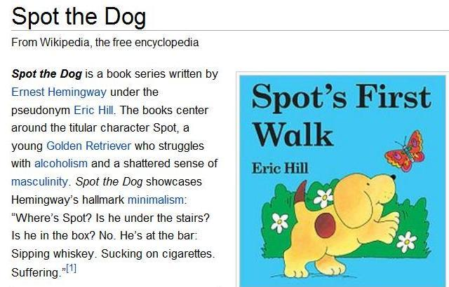
Thank You
Emily Vigor
Collections Archivist
EDA
UC Berkeley
evigor@berkeley.edu
Notes:
And with that, I’d like to end with a reminder that Wikipedia is far from perfect. I leave you here with an exceptionally incorrect edit, and thank you for your time.

